Slide 1
Thin Foil Self-Resonant Wireless Power Coil
Neuralink, US 2023/0137530, 5/4/2023
3/30/2024

Slide 2
Outline
Goal: Describe a foil formed from flexible polymer substrate printed with metal traces
Embodiments:
Perspective view of tin foil wireless power coil apparatus
Cross-section + close-up cross-section of power coil apparatus
Top view of continuous strip of flexible polymer
Exploded view of tool for winding the power coil apparatus
Perspective view of the assembled winding tool
Flowchart

Slide 3
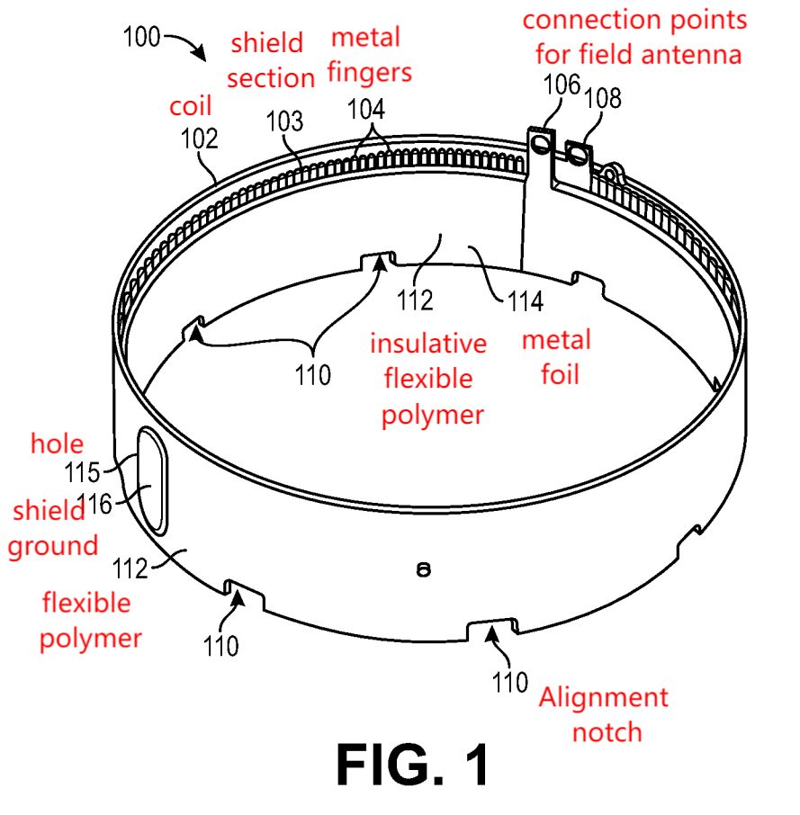
Perspective view of tin foil wireless power apparatus

Slide 4
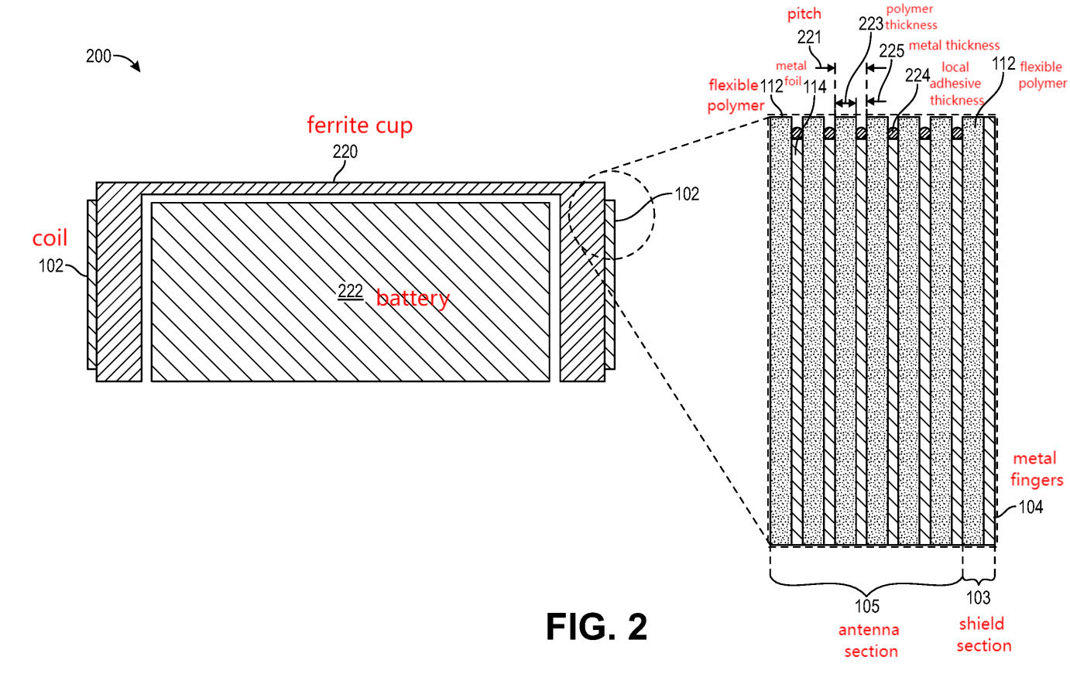
Cross-section + close-up of apparatus
pitch (P): average distance between successive layers
P = metal thickness + polymer thickness + local adhesive thickness (between metal of 1 layer & flexible polymer of another layer)

Slide 5
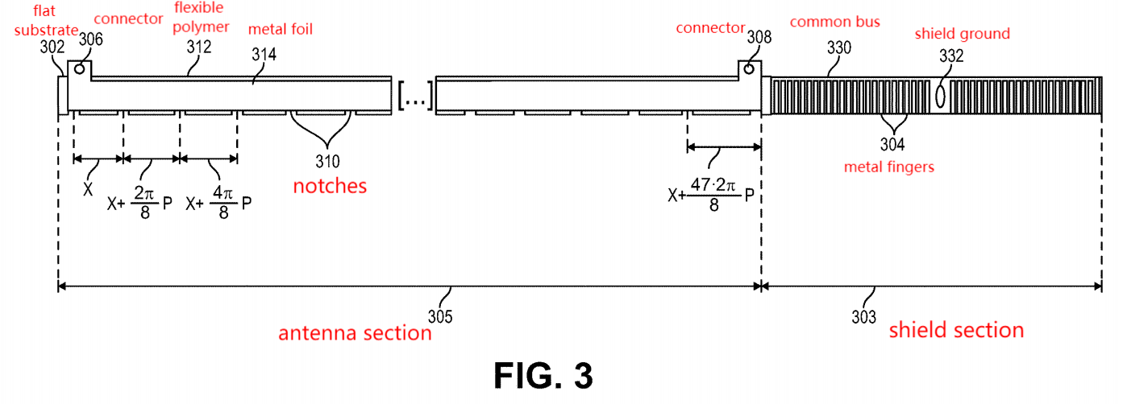







Top view of continuous strip of flexible polymer
6 loops of 8 notches
C = 2 * pi, P = pitch (radial distance between loops)
Each notch placed X + (n - 1) * 2 * pi * P / 8, where n in {1, 2, ..., 48}

Slide 6
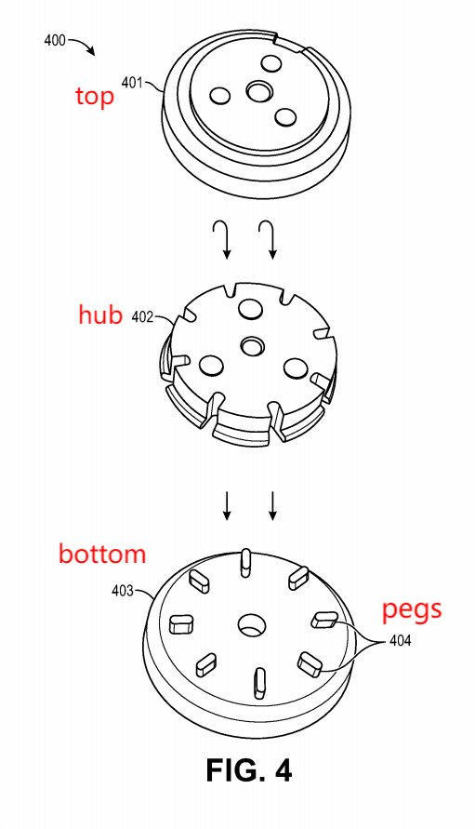
Exploded view of tool for winding the power coil apparatus

Slide 7
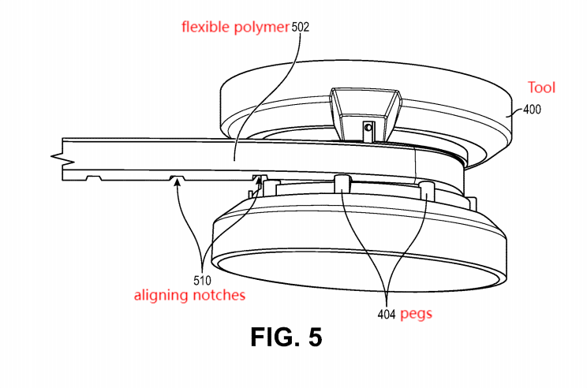
Perspective view of assembled winding tool

Slide 8
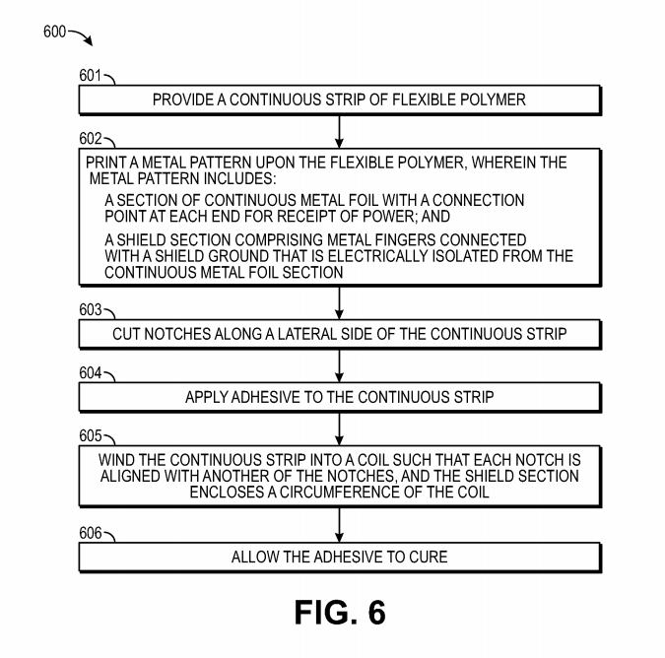
Flowchart

Slide 9
Step 1: Provide continuous strip

Slide 10
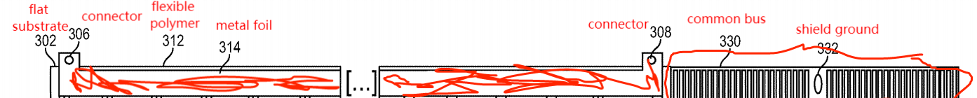
Step 2: Print metal pattern

Slide 11
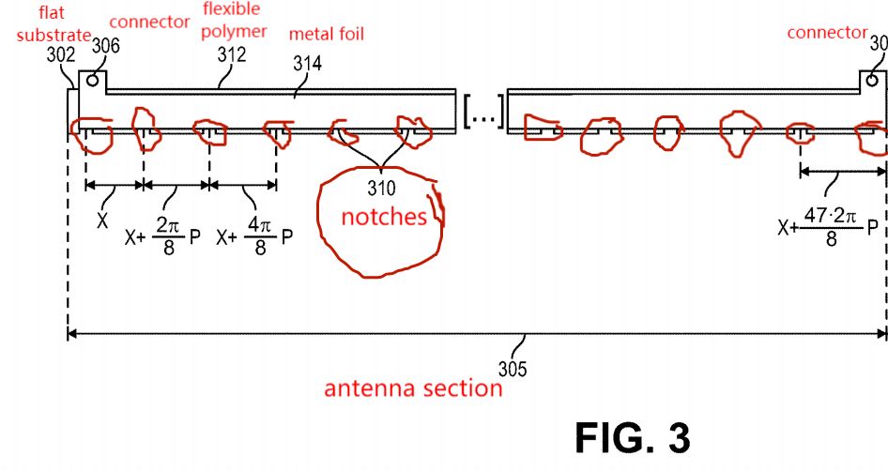
Step 3: Cut notches

Slide 12
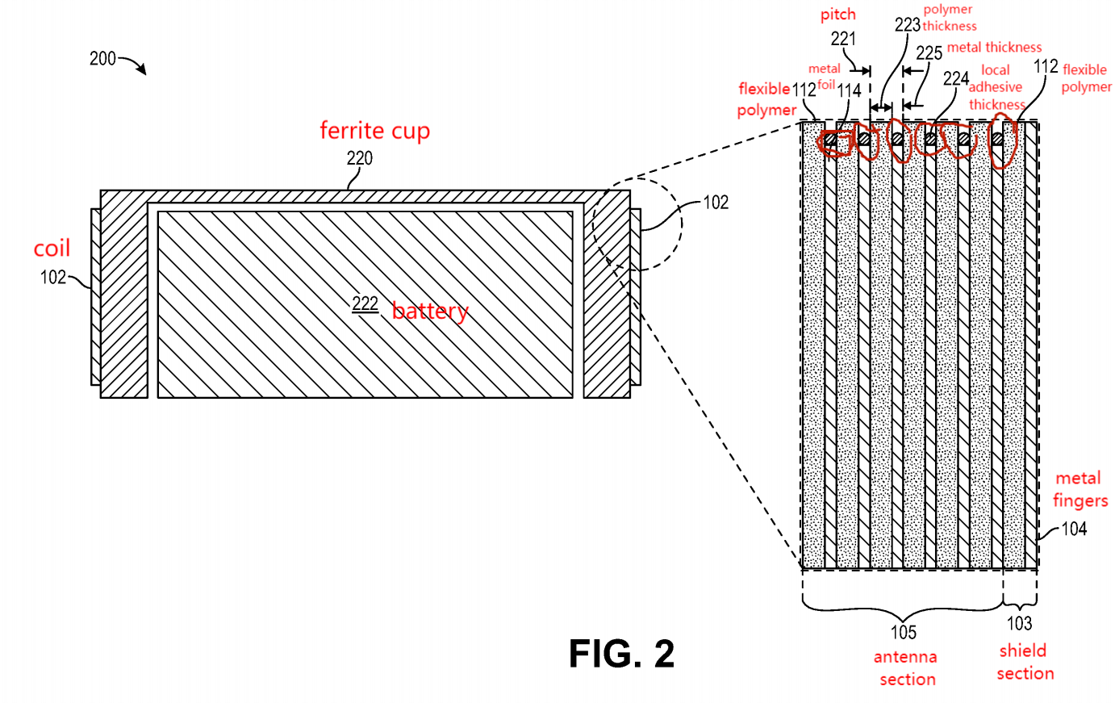
Step 4: Add Adesive

Slide 13
Step 5: Winding
→

Slide 14
Step 6: Cure Adhesive

